Slide 1
The orbital region
DR. HALAH ABBASS
L3

Slide 2
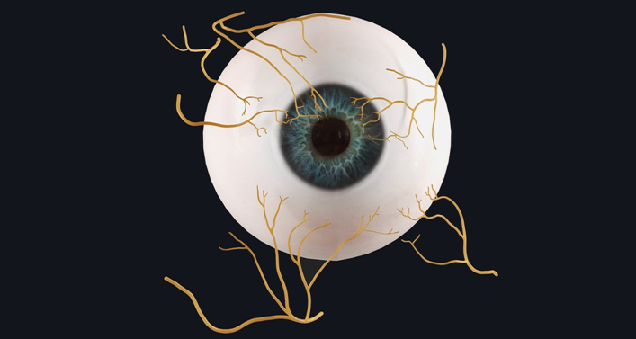

Slide 3
Nerves of the Orbit
Optic Nerve
The nerve is surrounded by sheaths of pia mater, arachnoid mater, and dura mater.
It pierces the sclera at a point medial to the posterior pole of the eyeball.
Here, the meninges fuse with the sclera; a rise in pressure of the cerebrospinal fluid (CSF) within the cranial cavity therefore is transmitted to the back of the eyeball.

Slide 4
Nerves of the Orbit
Lacrimal Nerve
The lacrimal nerve arises from the ophthalmic division of the trigeminal nerve.
Itis joined by a branch of the zygomaticotemporal nerve, which later leaves it to enter the lacrimal gland (parasympathetic secretomotor fibers).
The lacrimal nerve ends by supplying the skin of the lateral part of the upper lid.

Slide 5
Nerves of the Orbit
Frontal Nerve
The frontal nerve arises from the ophthalmic division of the trigeminal nerve.
It divides into the supratrochlear and supraorbital nerves that supply the skin of
the forehead; the supraorbital nerve also supplies the mucous membrane of the frontal air sinus

Slide 6
Nerves of the Orbit
Trochlear Nerve
It supplies the superior oblique muscle
Oculomotor Nerve
The superior ramus of the oculomotor nerve supplies the superior rectus muscle,then pierces it, and supplies the levator palpebrae superioris muscle . The inferior ramus of the oculomotor nerve supplies the inferior rectus, the medial
rectus, and the inferior oblique muscles

Slide 7
Nerves of the Orbit
Abducent Nerve
It supplies the lateral rectus muscle.
Nasociliary Nerve
The nasociliary nerve arises from the ophthalmic division of the trigeminal nerve;
it has the following branches:
The communicating branch to the ciliary ganglion is a sensory nerve.
The long ciliary nerves, two or three in number, contain sympathetic fibers for the dilator pupillae muscle.
The anterior ethmoidal nerve appears on the face as the external nasal branch at the lower border of the nasal bon and supplies the skin of the nose down as far as the tip.
The posterior ethmoidal nerve supplies the ethmoidal and sphenoidal air sinuses
The infratrochlear nerve supplies the skin of the medial part of the upper eyelid and the adjacent part of the nose

Slide 8
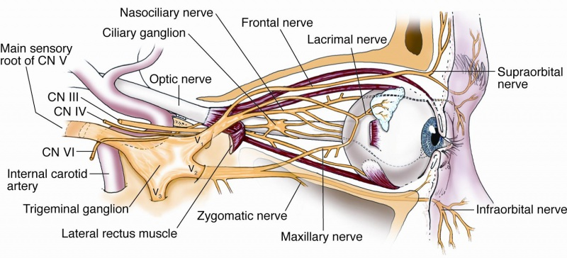

Slide 9
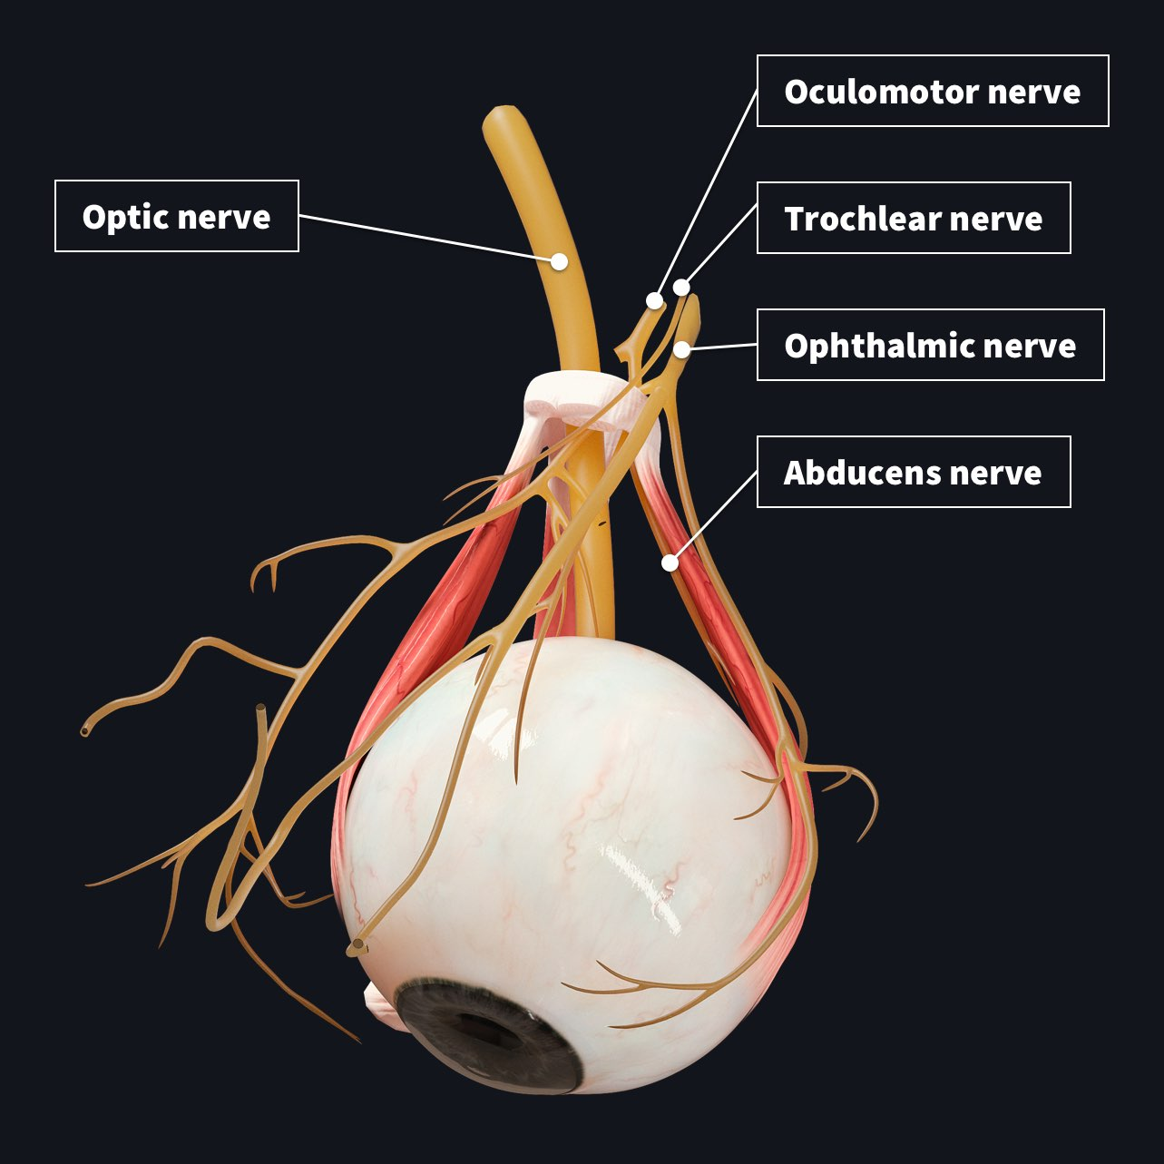

Slide 10
Blood and Lymph Vessels of the Orbit
Ophthalmic Artery
The ophthalmic artery is a branch of the internal carotid artery. It enters the orbit through the optic canal with the optic nerve It has the following branches:
The central artery of the retina enters the eyeball at the center of the optic disc. Here, it divides into branches, which may be studied in a patient through anophthalmoscope. The branches are end arteries.
✓ The muscular branches.
✓ The ciliary arteries can be divided into anterior and posterior groups.
✓ The lacrimal artery to the lacrimal gland.
✓ The supratrochlear and supraorbital arteries are distributed to the skin of the forehead

Slide 11
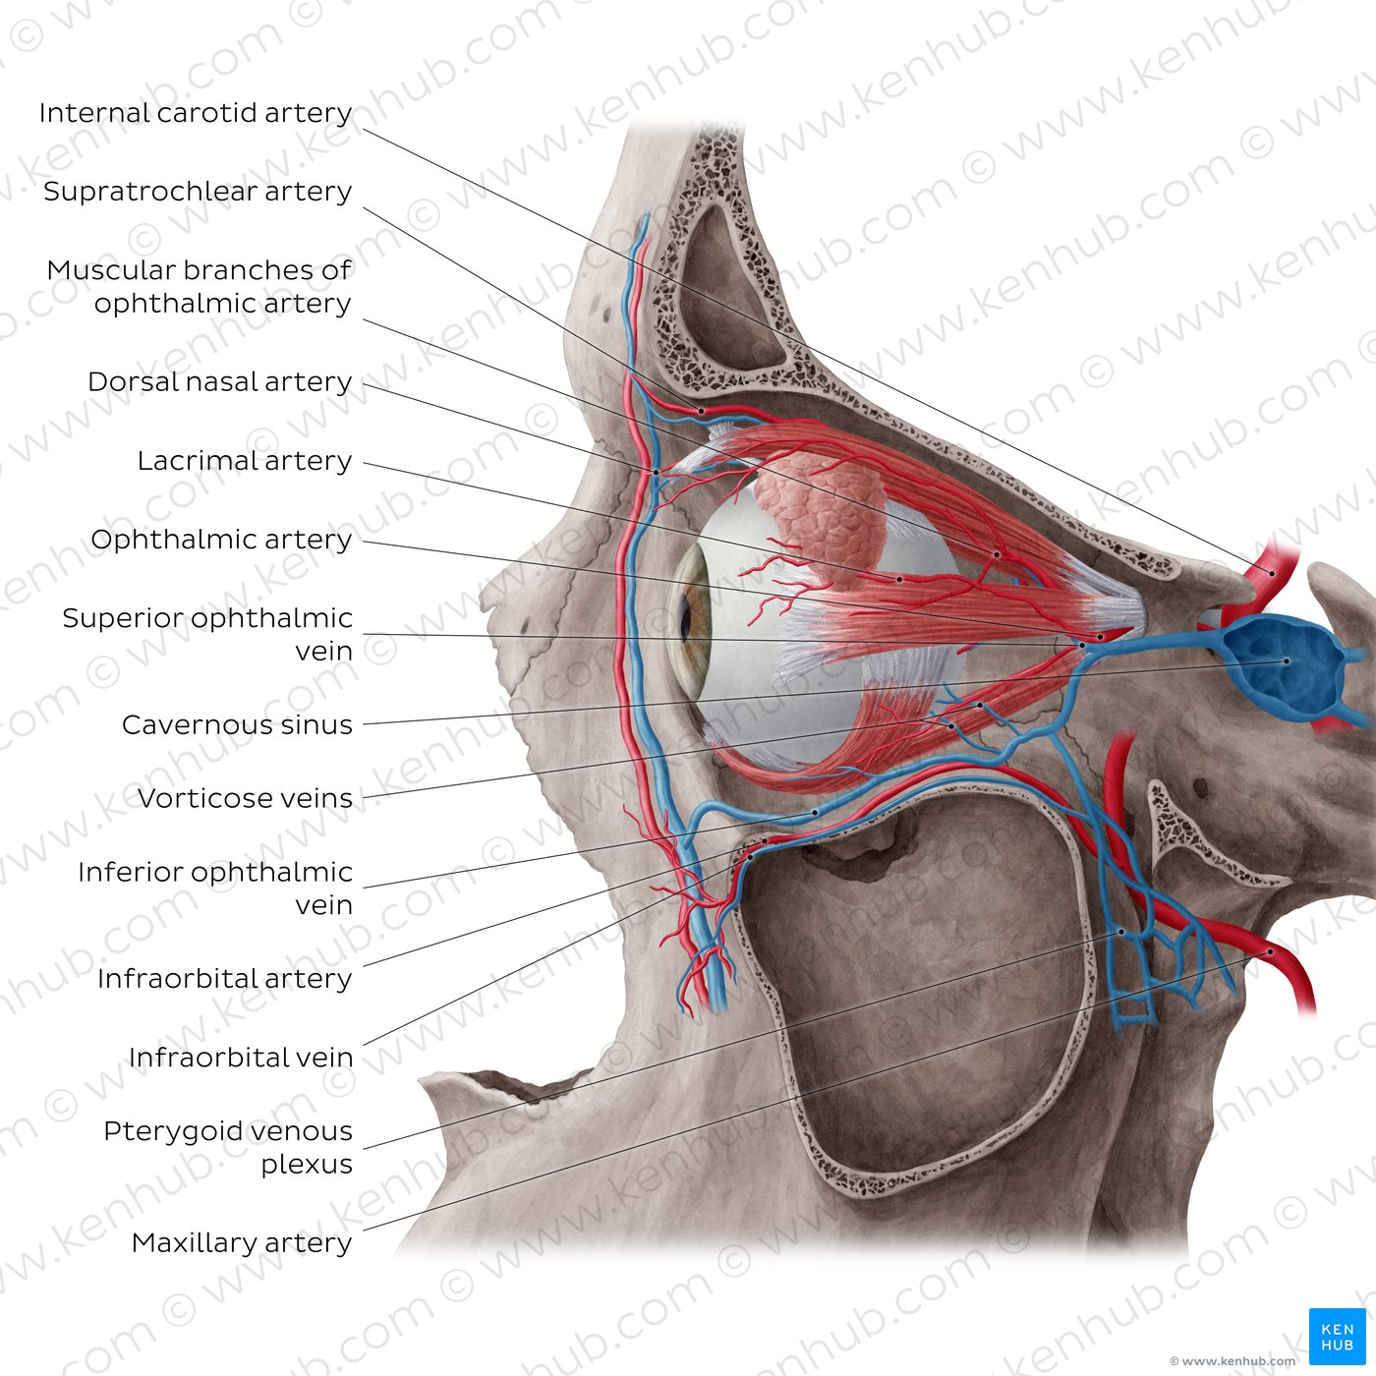

Slide 12
Ophthalmic Veins
The superior ophthalmic vein communicates in front with the facial vein. The inferior ophthalmic vein communicates through the inferior orbital fissure with the pterygoid venous plexus. Both veins pass backward through the superior orbital fissure and drain into the cavernous sinus.

Slide 13
Structure of the Eye
The eyeball is embedded in orbital fat but is separated from it by the fascial sheath of the eyeball. The eyeball consists of three coats, which are the fibrous coat,the vascular pigmented coat, and the nervous coat.

Slide 14
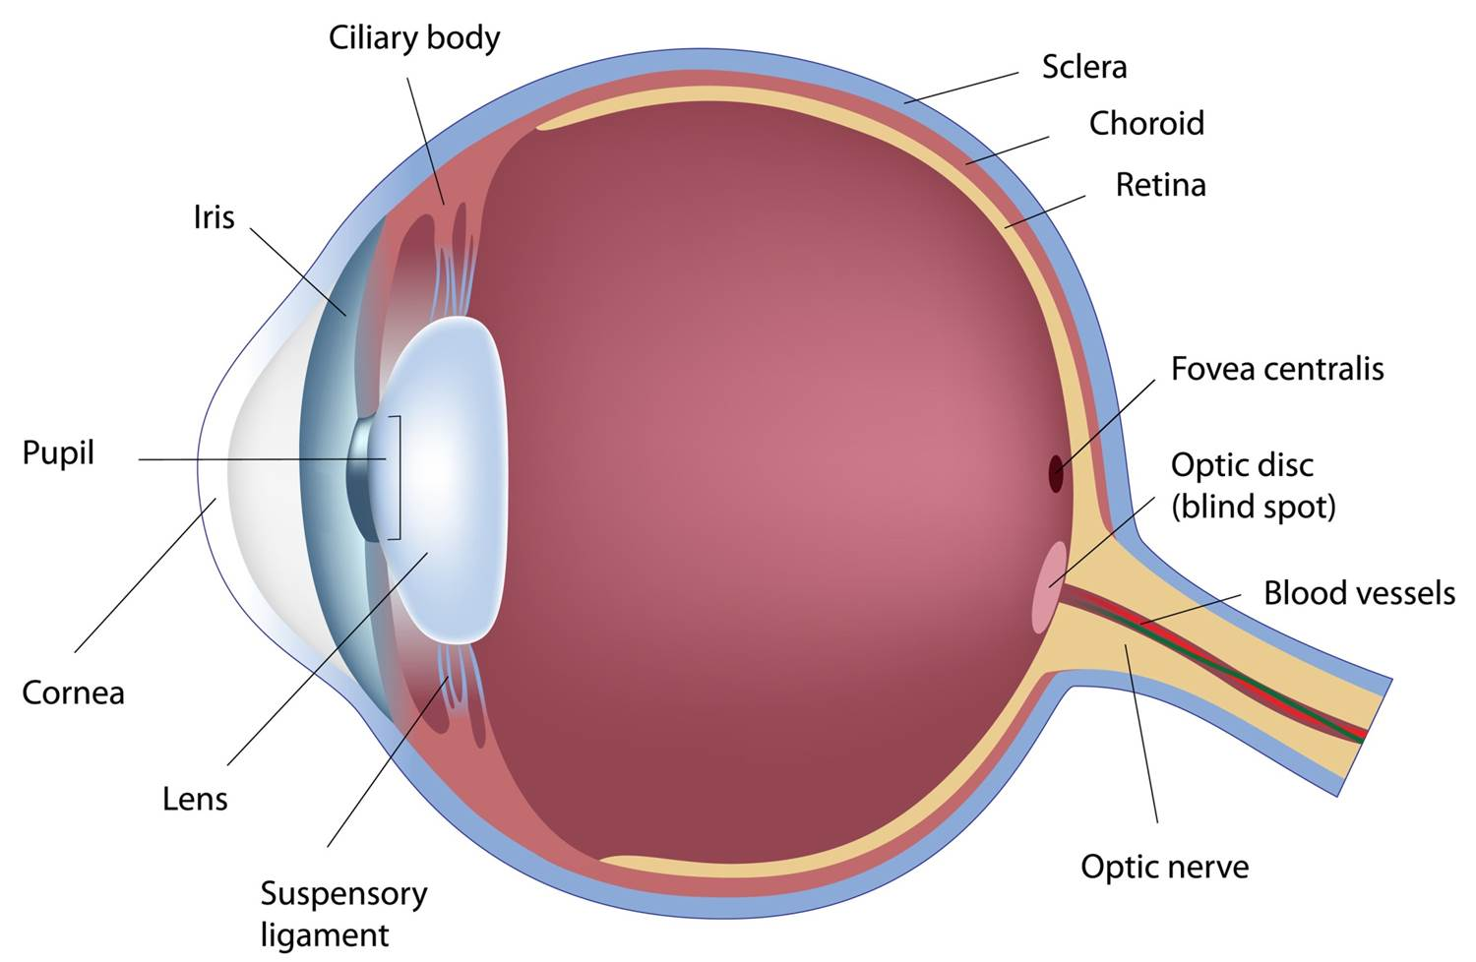

Slide 15
Fibrous Coat
The fibrous coat is made up of a posterior opaque part,
the sclera, and an anterior transparent part, the cornea The sclera is directly continuous in front with the cornea at the corneoscleral junction, or limbus. The transparent cornea is largely responsible for the refraction of the light entering the eye The cornea is avascular and devoid of lymphatic drainage. It is nourished by diffusion from the aqueous humor and from the capillaries at its edge.

Slide 16
Vascular Pigmented Coat
The vascular pigmented coat consists, from behind forward, of the choroid, the ciliary
body, and the iris.
The choroid is composed of an outer pigmented layer and an inner,
highly vascular layer.
The ciliary body is composed of the ciliary ring, the ciliary
processes, and the ciliary muscle.
The iris is a thin, contractile, pigmented diaphragm with a central aperture, the pupil
It is suspended in the aqueous humor between the cornea and the lens. The
muscle fibers of the iris are involuntary and consist of circular and radiating fibers.

Slide 17
Nervous Coat: The Retina
The retina consists of an outer pigmented layer and an inner nervous layer. Its outer
surface is in contact with the choroid, and its inner surface is in contact with the vitreous
body .The posterior three quarters of the retina is the receptor organ.

